Slide 1
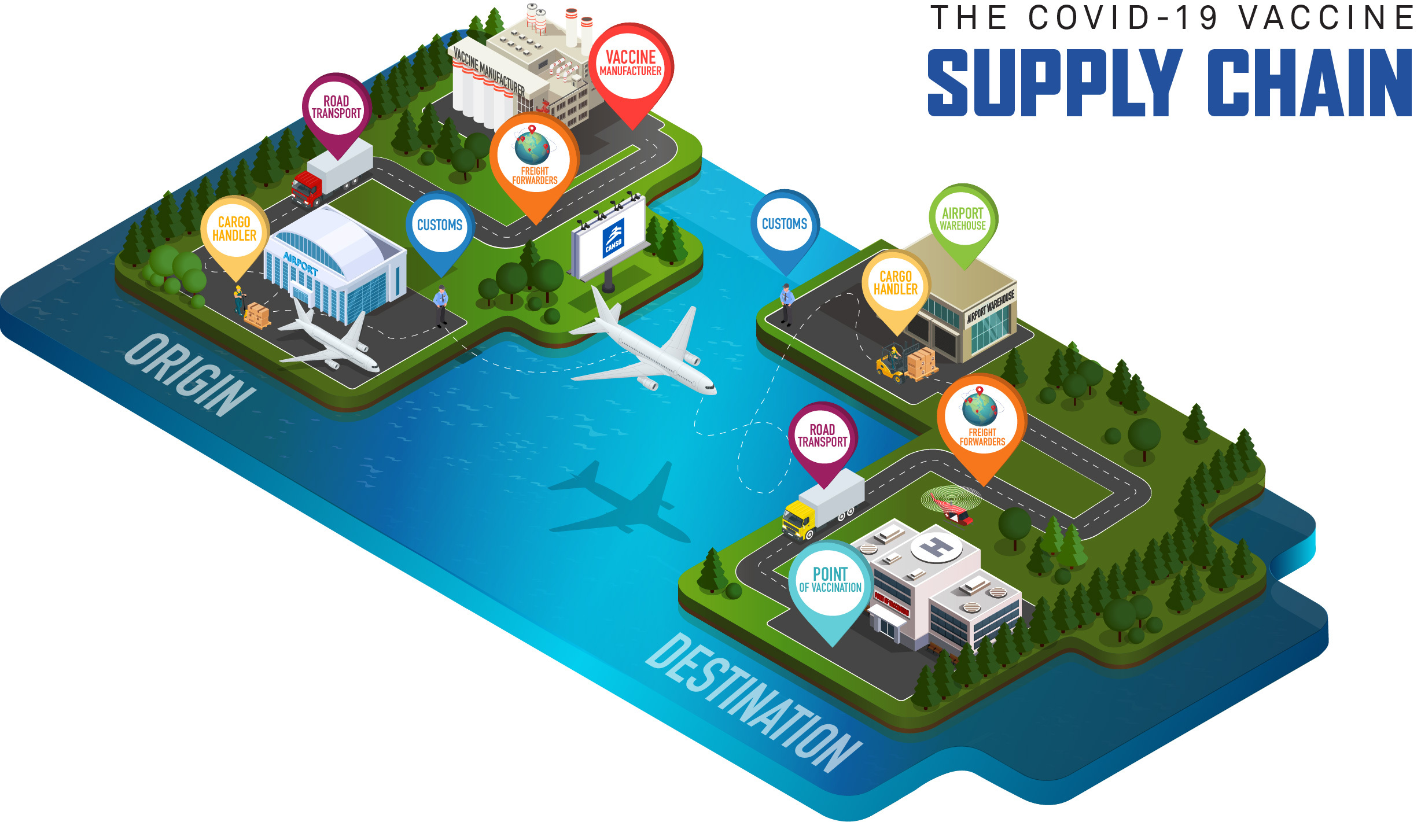
Building the Supply Chain for COVID-19 Vaccines
Presented By: Taran kumar

Slide 2
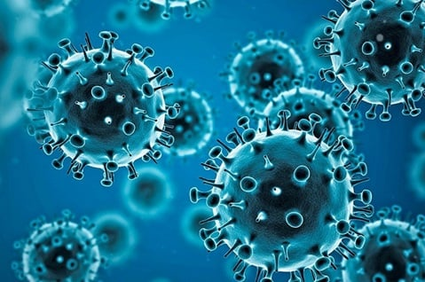
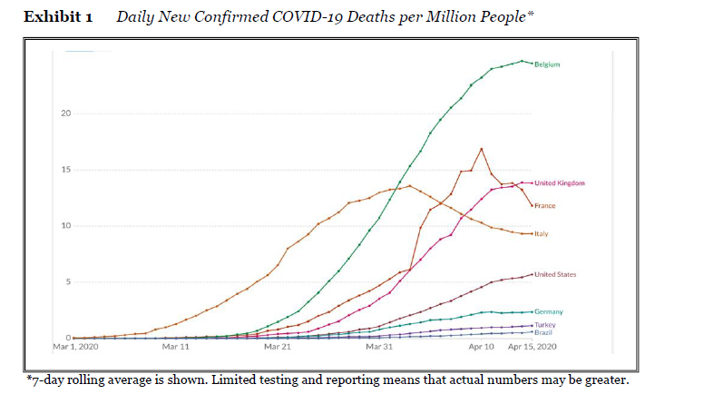
INTRODUCTION
Covid-19 is an infectious disease that is caused by the sars-cov-2 virus.
Started in 2019 and the first case was detected in Wuhan, China infecting 7 million people globally.
May-April 2020 there was a rapid escalation of the covid-19 pandemic
The government lockdown disrupted the demand and supply in all major industries including pharmaceutical, manufacturing, and service, and caused severe effects on the global economy.
The government navigated a trade-off between economic and public health outcomes. a global race had begun for the production, distribution, and discovery of an effective and safe vaccine to cure coronavirus.
Many experts predicted that the vaccine will not be effective partially and a lot of work needs to be done on it.

Slide 3

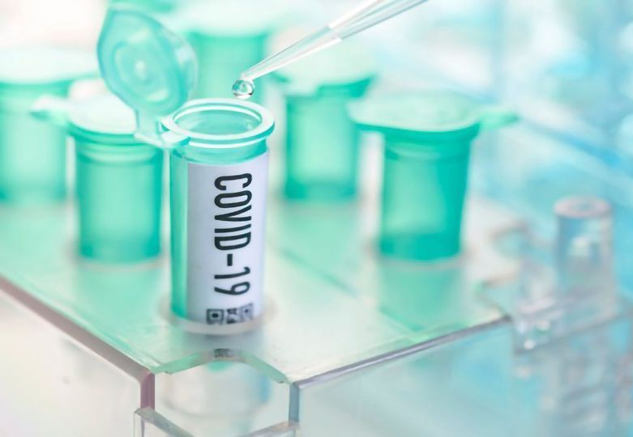
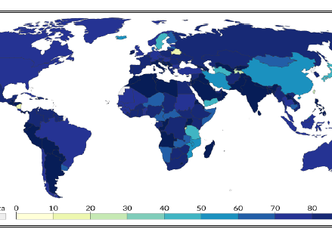
VACCINE DEVELOPMENT EFFORTS
WHO Declared a Global pandemic on March 2020.
By November 2020, vaccine development started at a high speed faster than any historical precedent.
Researched costs of around 200 to 500 million per vaccine
For COVID-19, lavish public and private financing, research grants, and advance purchase commitments by governments and international organizations de-risked the costly vaccine development effort and allowed developers to explore and test the vaccine for human use.
Primary international effort known as the COVID-19 Vaccine Global Access (COVAX) aims to pool resources to introduce vaccines and later give subsidized access to lower-income groups.
Beyond COVAX and Operation Warp Speed, other countries also supported vaccine candidates through research grand and advance purchase agreement
This search had yielded a global portfolio of some 321 vaccine candidates by early fall 2020,

Slide 4
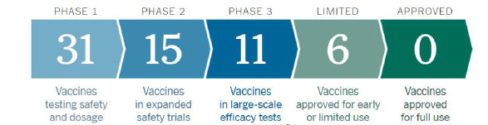
Process Overview and Challenges in Clinical Trials
The process of developing a vaccine is divided into three phases spread over several years: research(lasted 2-4 years), testing, and manufacturing
Experts predicted that the inaugural COVID-19 clinical vaccine trial would be finished in 8months and the majority of COVID-19 vaccine candidate phase II trials were omitted or combined with bigger trials.
The historical average for the complex vaccine was 9.4years
Effectiveness of vaccination was tough to prove because of a lack of evidence of covid incidence rates, undetected transmission, trial design, and stopping rules were more difficult to devise.
Phase III trials for COVID-19 commonly involved around 40,000 subjects, about 20,000 in each group. Given a 1% attack rate, 200 subjects in each group would be expected to become infected over time

Slide 5
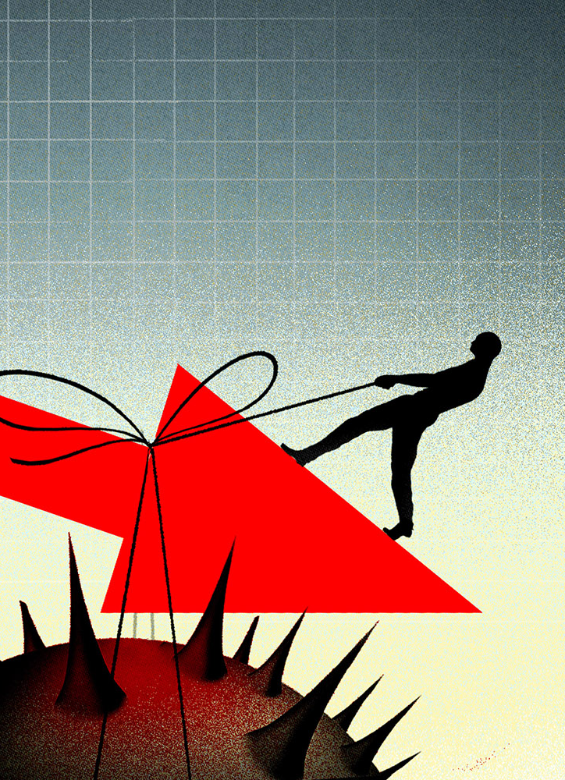
POLITICS AND THE TEMPTATION TO RUSH THROUGH THE SCIENCE
Increasing economic and political pressures threatened to tempt governments to approve vaccine candidates prematurely
US worried about elections and outside the COVAX initiative, they pushed for the release of the vaccine before the elections without waiting for the results of clinical tests.
The tendency towards premature approval had been more apparent in some countries. Russia remained outside of the COVAX initiative and announced early approval.
Due to rush manufacturing and distribution, there was a risk that public trust can easily be broken in vaccination programs.
Proper manufacturing quality assurance systems were required for the safety and effectiveness of each dose.

Slide 6
VACCINE TECHNOLOGIES AND PORTFOLIO DIVERSIFICATION ALONG WITH SECOND-GENERATION VACCINE CHALLENGES
Despite the large diversity of first-generation vaccine candidates, there were concerns over the politically-motivated exclusion of certain candidates
There were issues with large public investments in early-movers
TO encourage the regular production of vaccines and to invest highly in vaccine development, some governments like the US, UK, and EU along with COVAX made advance purchase commitments and gave funds.
Now, the challenge was that vaccine released by 2020 or early 2021 will only provide partial protection and will not be suitable for global distribution
Second-generation vaccine was supposed to be introduced by September 2023 so measures like social distancing and mask-wearing would likely need to be continued
Concerns had been raised that a partially effective first-comer COVID-19 vaccine could crowd out the market for more effective vaccines further down in the pipeline

Slide 7
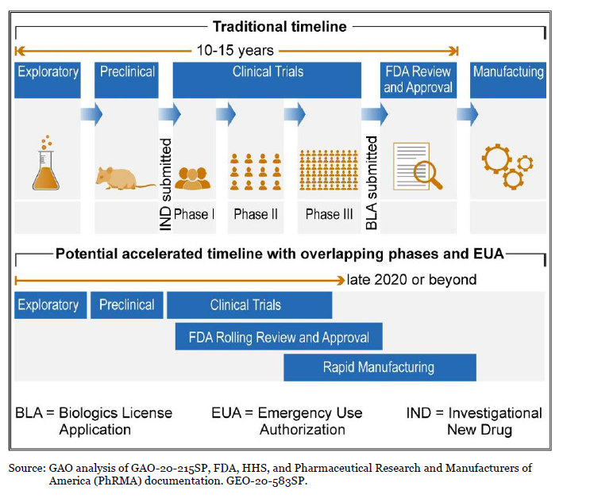
MANUFACTURING AND PROCESS OVERVIEW
Once the vaccine candidate had proven effective in Phase III trials then manufacturing capacity was typically created
Construction of manufacturing took around 2-3 years and required further 2-3 years for the efficient vaccine in significant amounts.
Companies were unable to invest heavily without any support from governments.
Vaccine manufacturing was difficult and contain complex biological processes that also included the time consumed for quality control procedures.
Test and quality accounted for almost 70% of production time.
Production Process consisted of two stages: Drug substance production and drug product manufacture.
Global portfolio of vaccine candidates included a variety of diversified technology platforms that had different manufacturing requirements and processes.
Different manufacturing requirements and processes require an entirely new production line which means heavy investment.

Slide 8
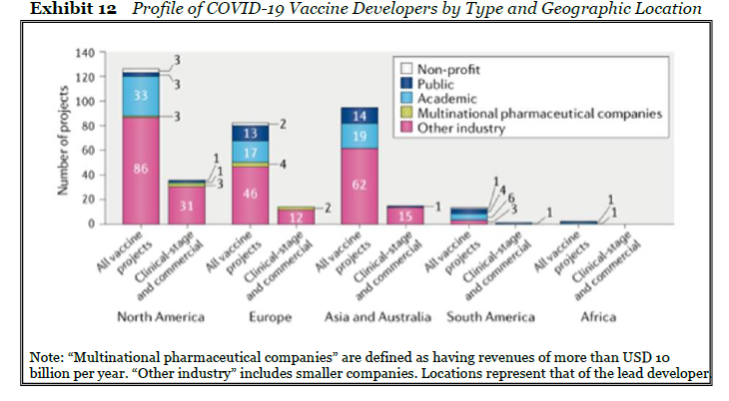
CHOICE OF PRODUCTION SITES AND ECONOMIC GEOGRAPHY OF VACCINE MANUFACTURING
Popular nations like China, Brazil, and India had major investments to meet local demand for vaccine capacity.
Complex nature of vaccination production requires a well-trained workforce and strong regulatory support
Due to historical experience and cost of production manufacturing cluster had developed in Japan, North America, and South Korea.
Decisions were made complicated due to political tension such as the pre-pandemic trade war between US and China
Local pressure to reserve initial distribution for domestic people instead of helping others
Nationalist pressure was also exerted on the demand and investment side
However due to the small population in Singapore, Hongkong, and Luxemburg, they were able to export vaccination to other countries that needed it the most.

Slide 9
RAW MATERIAL AND COMPONENT SUPPLY + SCALING RISKS
Shortage of packaging material and ingredients and vaccine manufacturing efforts proved slower through the fall of 2020.
Companies like Pfizer and Moderna announced slower growth and production due to a shortage in components and manufacturing equipment supplies
Actions were taken to mitigate this shortage that included global cooperation and coordination, horizontal collaboration across competing developers and manufacturers, and speculative manufacturing.
Companies invested in developing manufacturing in parallel with clinical trials but mass production was harder than expected
Companies that decided to produce 100million vaccines ended up producing like 50million only
major reasons for this was also that rushing to meet demand was resulting in poor quality and safety compromises which were then resulting in recalls of vaccination

Slide 10
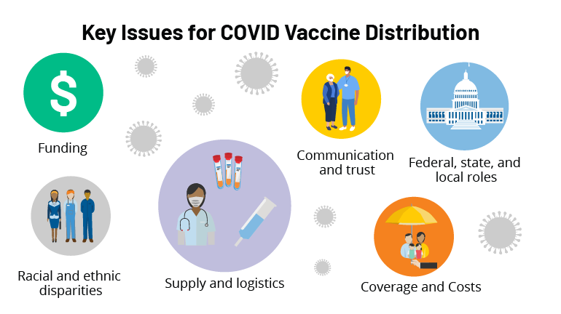
AGILY CAPACITY + DISTRIBUTION
Grants from the government protected developers from the possibility of unsuccessful trials to some extent.
Serum invested around USD 300 to USD 500 million in the land, building, and equipment
Switching costs due to failing trails were also high.
To deal with all this and distribution they come up with different solutions.
organizations emerged two camps around distribution: 1) multilateral cooperation and 2) bilateral agreements between a country and a drug company
Other countries like the USA announced their own approach to distribution
COVAX spread risk among applicants and made sure that lower-income countries that the vaccination.
US Centers for disease control announced a phased distribution strategy.

Slide 11
Willingness And Transportation Challenges + Questions Going Forward
challenge of growing vaccines was the hesitation of people to being vaccinated
vaccines require a certain temperature and controlling temperature, as well as logistics, was a huge issue as reported by WHO.
each vaccine was requiring different temperature capacitates
diversity of requirements of vaccine temperature created significant challenges in distribution and complicated infrastructure requirements
UPS announced in the US and Germany to construct cold storage facilities each with 600 freezers able to accommodate 48,000 vials of the vaccine in insulated boxes of dry ice that would maintain the proper temperature for up to 96 hours
Considering these challenges proper planning was an important step in the supply chain with billions of vaccine doses needed and fear of significant losses in cold transit, even seemingly minor operational decisions related to batching and allocating vaccine doses could critically affect the distribution and as well as, lives
Going forward by Nov 2020, Covid-19 vaccine development saw major developments but still some vaccine candidates face development and manufacturing risk.

Slide 12






